Slide 1
Reshaping data using R
James Gwinnutt

Slide 2
Outline
What is reshaping
How to do it in R

Slide 3
Reshaping
There are two ways to store clustered data (e.g. longitudinal data, hierarchical data)
Long
Wide
Example

Slide 4

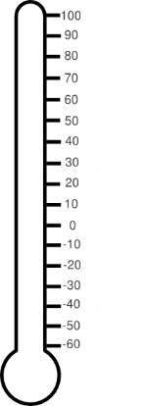
Reshaping
Baseline
6 hours
12 hours
001
001
001
38.3°
38.1°
37.6°

Slide 5
Long
ID | Time (hours) | Temperature (degrees)
001 | 0 | 38.3
001 | 6 | 38.1
001 | 12 | 37.6
Wide
ID | Temperature_0 | Temperature_6 | Temperature_12
001 | 38.3 | 38.1 | 37.6

Slide 6
Reshape in R
Two packages to do this
tidyr – pivot_longer & pivot_wider (formerly gather and spread)
reshape2 – melt and cast

Slide 7
Example dataset
Blood pressure data
120 people
Blood pressure data, “before” and “after” an intervention
bplong <- foreign::read.dta('https://www.stata-press.com/data/r8/bplong.dta')

Slide 8
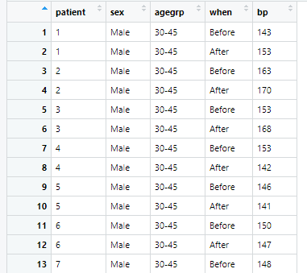

Slide 9
Tidyr
pivot_wider to convert the data from long to wide format
bpwide <- bplong %>% pivot_wider(names_from = 'when', values_from = 'bp')
New (wide) dataframe
Follow-up variable name
Measured variable(s)
Function
Original (long) dataframe

Slide 10
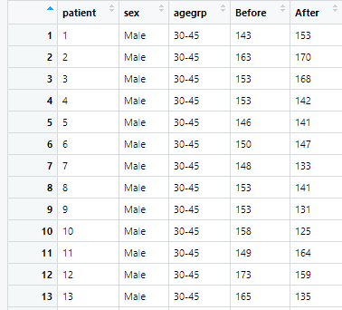

Slide 11
2 measured variables?
New variable
bplong$test <- bplong$bp + 1000
bpwide2 <- bplong %>% pivot_wider(names_from = 'when', values_from = c(bp, test))
Use c() to make a list of variables

Slide 12
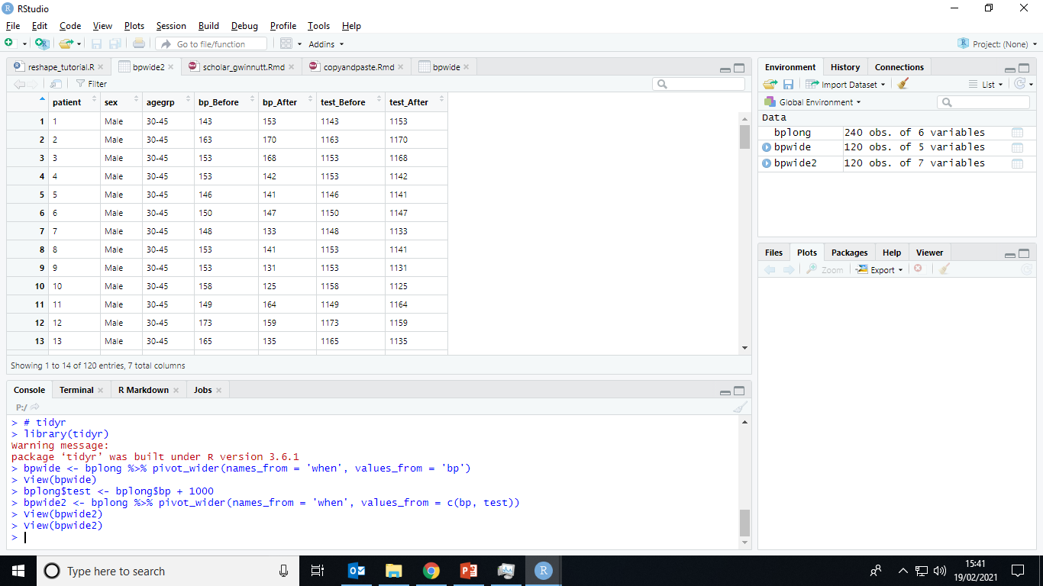

Slide 13
Back to long
pivot_longer to convert data from wide to long

Slide 15
Back to long
pivot_longer to convert data from wide to long
bplong2 <- bpwide %>% pivot_longer(c(Before, After), names_to = 'timepoint', values_to = 'bp')
New (long) dataframe
New variable denoting the timepoint
Function
New name for measured variable
Original (wide) dataframe
Variables to convert from wide to long

Slide 16
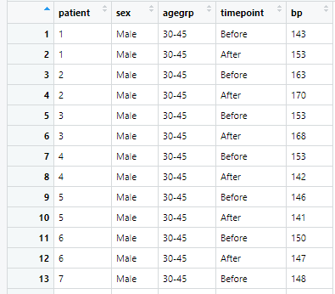

Slide 17
Multiple variables

Slide 18
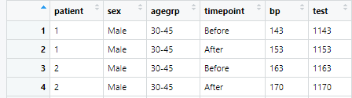
Multiple variables
Pivot all variables except these
New variable names
bplong3 <- bpwide2 %>%
pivot_longer(cols = -c(patient, sex, agegrp),
names_to = c(".value", "timepoint"),
names_pattern = "([A-Za-z]+)_([A-Za-z]+)")
Variable naming pattern

Slide 19
reshape2

Slide 20
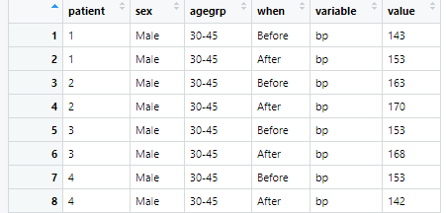
reshape2
First ‘melt’ the dataframe
molten <- melt(bplong, measure.vars = 'bp')

Slide 21

reshape2
Then ‘cast’ it to desired shape
bpwide <- dcast(molten, patient + sex + agegrp ~ when)

Slide 22
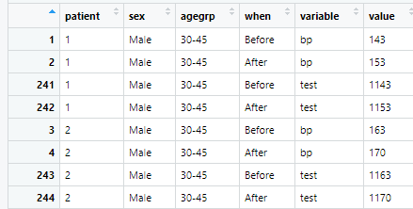
Multiple variables
bplong$test <- bplong$bp + 1000
molten2 <- melt(bplong, measure.vars = c('bp', 'test'))

Slide 23

Multiple variables
bpwide2 <- dcast(molten2, patient + sex + agegrp ~ variable + when)

Slide 24
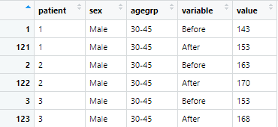
Reshape2 – wide to long
bplong2 <- melt(bpwide, id.vars = c("patient", "sex", "agegrp"))

Slide 25
Multiple variables

Slide 26
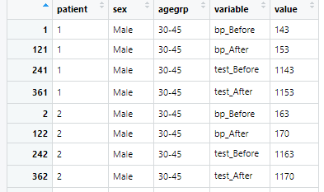
Multiple variables
bplong3 <- melt(bpwide2, id.vars = c("patient", "sex", "agegrp"))
Not very satisfying

Slide 27
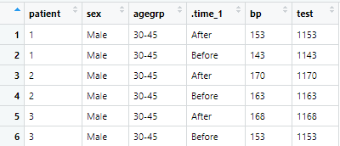
library(splitstackshape)
bplong3 <- merged.stack(bpwide2, id.vars = c("patient", "sex", "agegrp"),
var.stubs = c("bp", "test"), sep = "_")

Slide 28
Learn more here
David’s page: https://personalpages.manchester.ac.uk/staff/david.selby/stata/2021-02-02-refinements/#reshaping-data

